Slide 1
Trends and steps toward continuous improvement in policing
Ken Wallentine
Chief of Police
West Jordan, Utah
UMAA Spring Conference
May 3, 2023

Slide 2
Nationwide trends in police reform
Limitations on vascular restraint
UOF investigative independence
Big data collection
Training mandates
Body worn camera mandates
No-knock warrant limitations
Certification & discipline powers

Slide 3
Utah reform statutes
Utah Code § 53-13-115
Utah Code § 53-6-202
Utah Code § 76-2-408
Utah Code § 77-7-8
Utah Code § 77-7a-102
Utah Code § 59-6-210
Utah Code § 53-22-101
Utah Code § 53-6-202
Utah Code § 53-6-211
Utah Code § 53-14-202

Slide 4
Police service demands and crime trends
See-saw criminal penalties for drugs
Catalytic converter & metals theft
Fewer cops, geographic shifts
Technology
Intelligence-led policing
Institutional abrogation of services

Slide 5
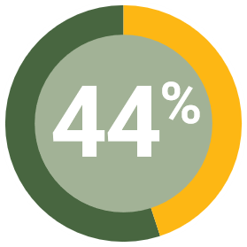
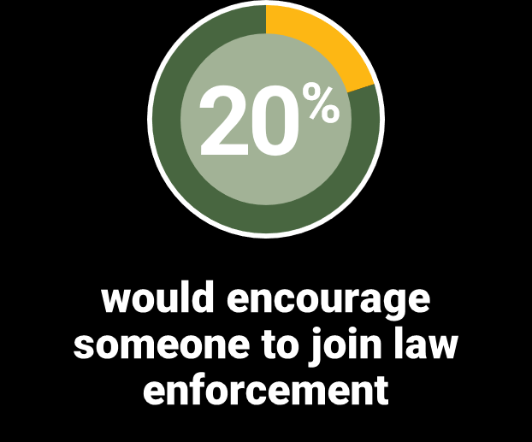
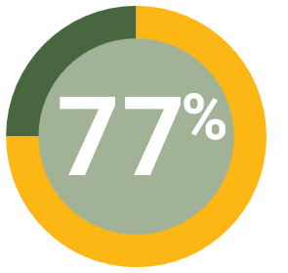
Survey of 2,400 officers revealed:
44% plan to leave in the next few years
20% would encourage someone to join
77% say that morale has declined in the last year
“Officers told us over and over again what they want from their leaders in 2022: To communicate…to be consistent…to care.”

Slide 6
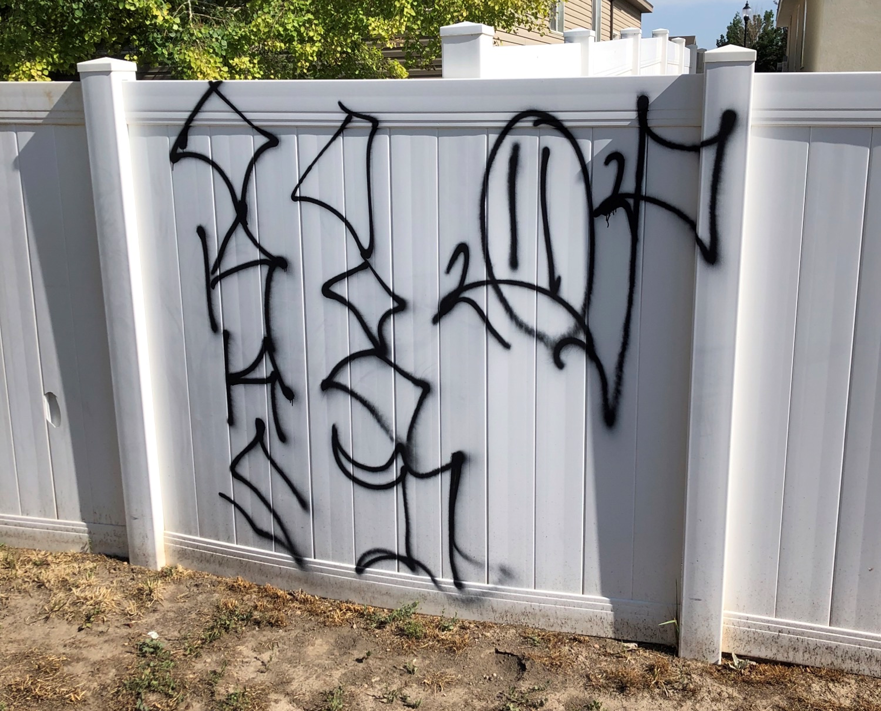
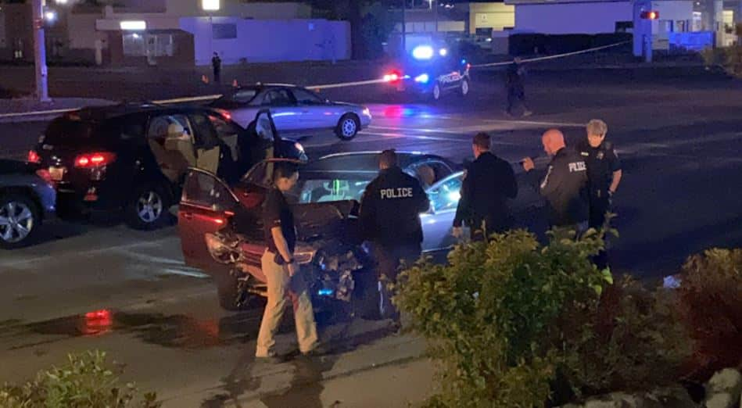
As night follows day . . .

Slide 7
Why you should care about Heck v. Humphrey
The Supreme Court held that a plaintiff could not bring a civil rights claim for damages under § 1983 based on actions whose unlawfulness would render an existing criminal conviction invalid.

Slide 8
Traditional claims
Use of Force
Pursuit & other EVO
Search & Seizure
Unlawful Harassment
Retaliation
EDPs/Mentally Ill

Slide 9
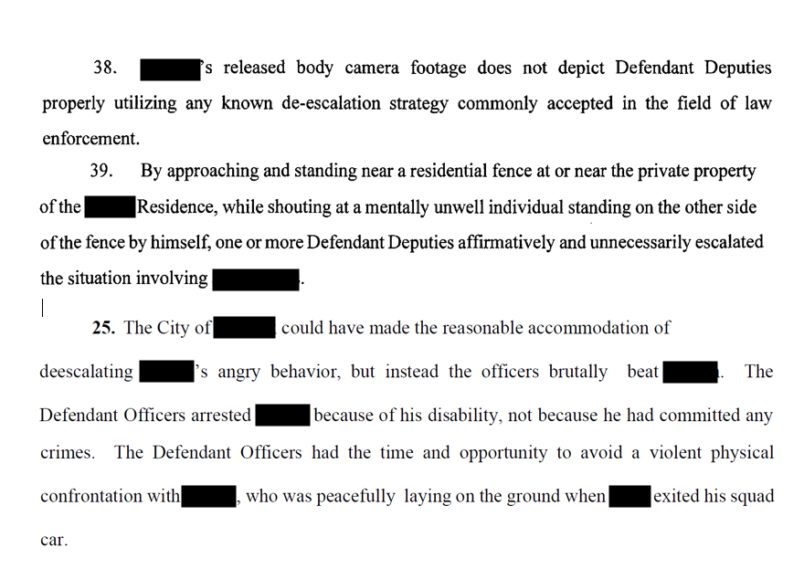
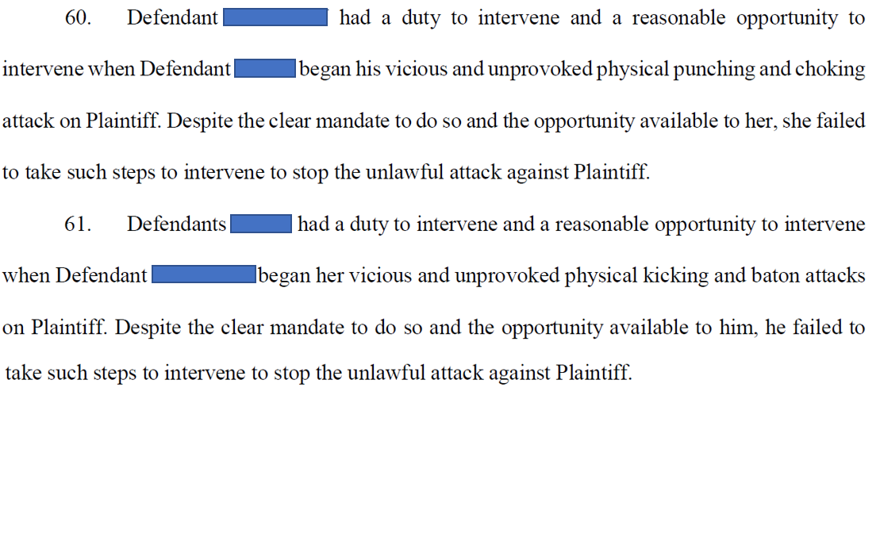
Liability for failure to train

Slide 10
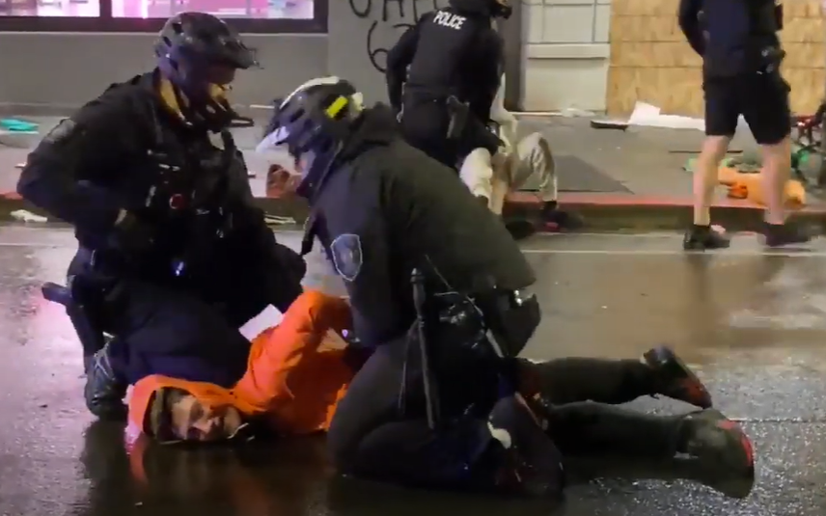
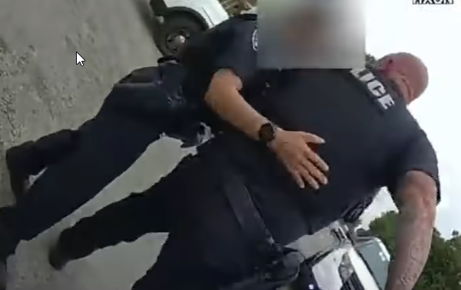
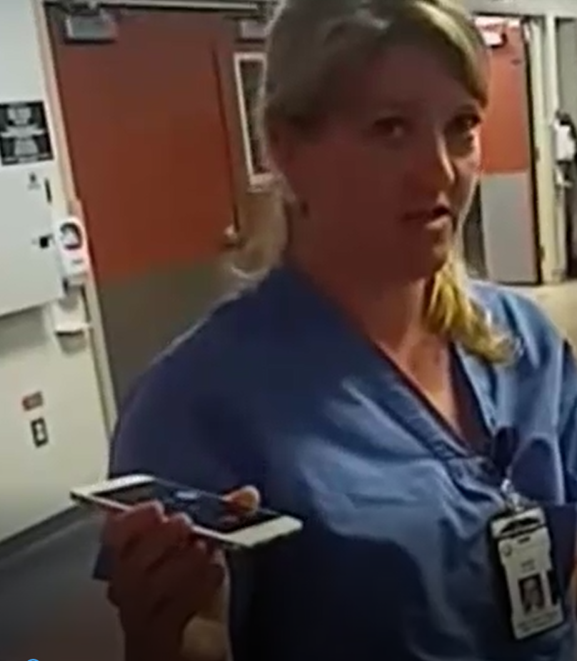
Duty to Intervene (SB 26)

Slide 11
REDUCE MISTAKES
PREVENT
MISCONDUCT
PROMOTE
HEALTH &
WELLNESS
The Three Pillars of ABLE
Active Bystandership & SB 126

Slide 12
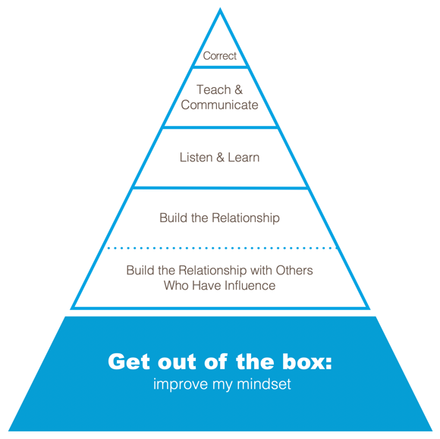
You matter like I matter:
Seeing the other person’s needs, goals, objectives, challenges
Teaching mindset to drive
de-escalation behaviors

Slide 13
Developing and Implementing an Outward Mindset in Policing
Outward Inclusion

Slide 15
Traditional police response to mental health calls:
Complainant calls, dispatch sends, cops roll
Is cost/benefit analysis the new practice?
You call, we roll?
(we bring guns, uniforms, noise, flashing lights!)

Slide 16
Adult man is locked in his house
He broke windows, said that he’d kill himself
He has a history of brandishing knives and mental health calls
Police respond and negotiate for 75 minutes
How would you like us to respond?

Slide 17
Is there a crime?
If not, what are the police doing here?
What is the legal duty?
Do your police practice “tactical repositioning?”
Listen to Hippocrates:
Primum non nocere

Slide 18
Questions? Comments?
ken.wallentine@westjordan.utah.gov
www.linkedin.com/in/kenwallentine
801-256-2000

Slide 19
Disclaimer
The materials provided in this presentation are for general informational and educational purposes only. The materials are not intended to be and should not be considered legal advice or opinions. You should not act upon any information presented without first seeking legal counsel on your specific matter.

