Slide 1
Professionalism & Civility
UMAAC 2023
Lowry Snow

Slide 2
CLE Ugh----Some History

Slide 3
When and why did you decide to become a lawyer?

Slide 4
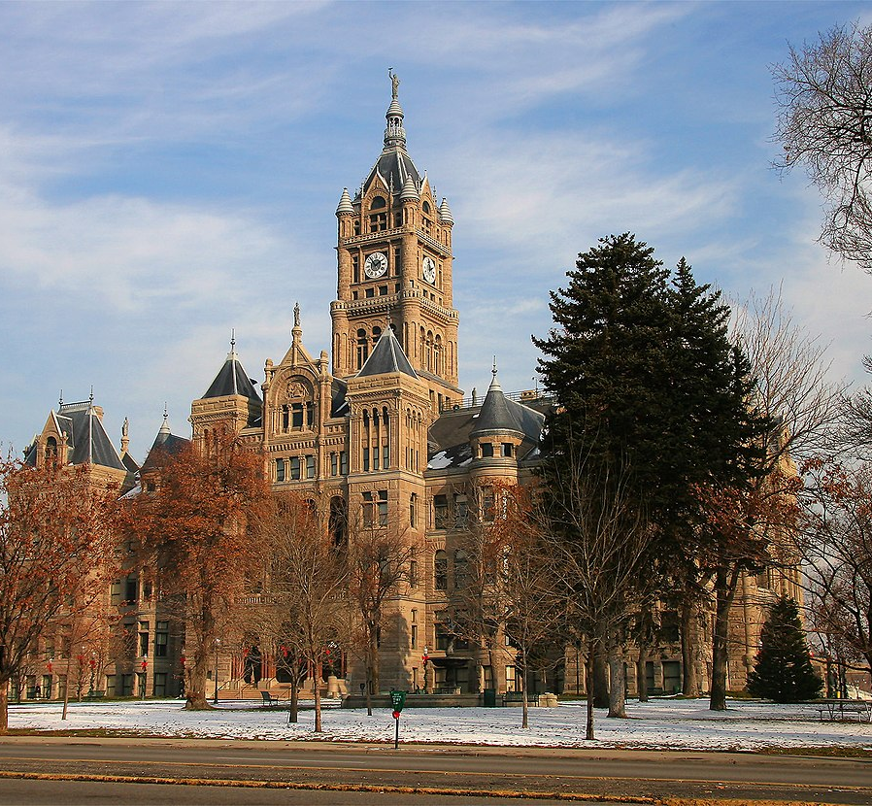
What is your role as municipal attorney?

Slide 5
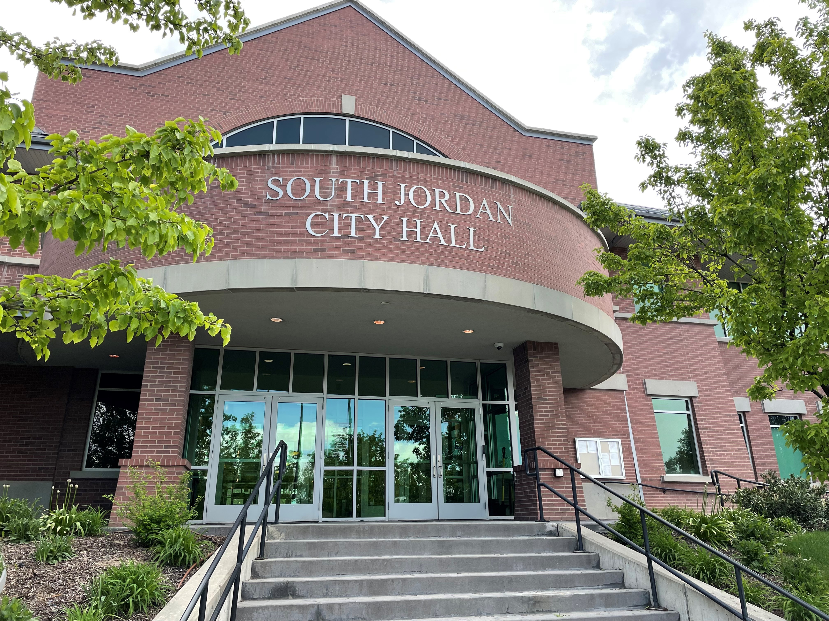
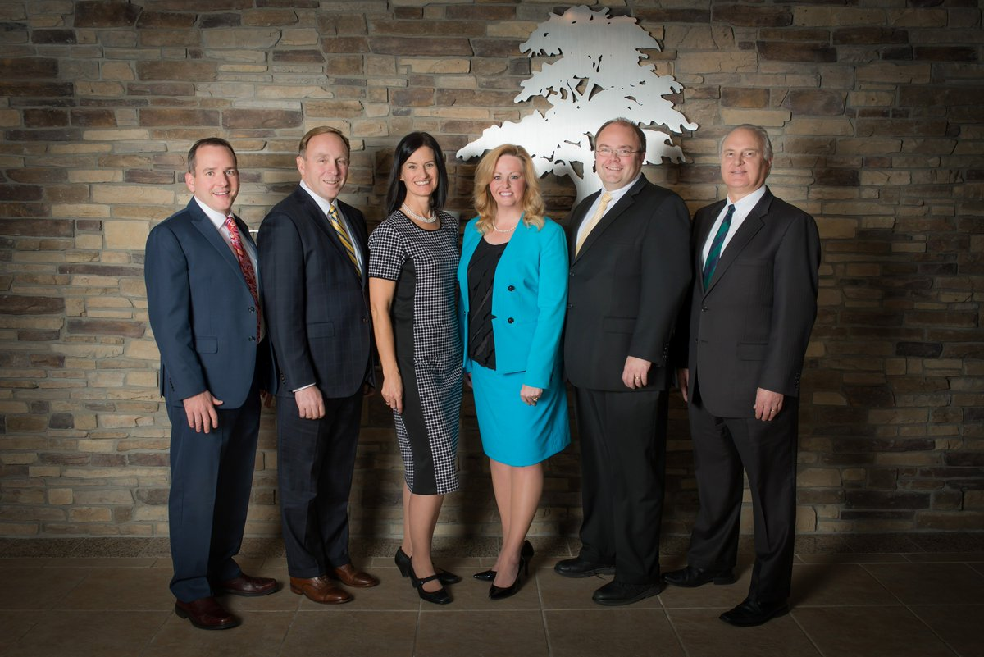
Who is your client?

Slide 6
Standards of Professionalism and Civility------In the Beginning..
In 2001, the Utah Supreme Court created the Advisory Committee on Professionalism. That committee drafted Utah’s Standards of Professionalism and Civility.
In 2003, the Utah Supreme Court adopted the Standards of Professionalism and Civility.
Utah’s federal trial courts endorsed the standards: “The court adopts the Utah Standards of Professionalism and Civility to guide attorney conduct in cases and proceedings in this court.” Utah Dist. Local Rules of Practice, DUCiv R83-1.1(g)
In 2009, Utah Supreme Court modified the attorney’s oath to include adherence to Utah’s Standards of Professionalism and Civility.

Slide 7
Preamble to the Standards of Professionalism and Civility.
Highlights the importance of attorneys being civil and courteous, while engaging in conduct and imposes duty of professional integrity.
Standards are designed to encourage attorneys to meet their obligations to each other, to litigants and the system of justice.
Adherence is expected as part of a commitment to improve the administration of justice in our state.
Emphasizes the duty of both lawyers and judges to educate clients and litigants by making it clear that not adhering to the standards may hurt the client’s case.
The standards should be followed by both lawyers and judges in all interactions and in all proceedings.
The
Preamble

Slide 8
Standard #1
Lawyers shall advance the legitimate interests of their clients, without reflecting any ill-will that clients may have for their adversaries, even if called upon to do so by another. Instead, lawyers shall treat all other counsel, parties, judges, witnesses, and other participants in all proceedings in a courteous and dignified manner. (Emphasis added)

Slide 9
Standard #2
Lawyers shall advise their clients that civility, courtesy, and fair dealing are expected. They are tools for effective advocacy and not signs of weakness. Clients have no right to demand that lawyers abuse anyone or engage in any offensive or improper conduct.

Slide 10
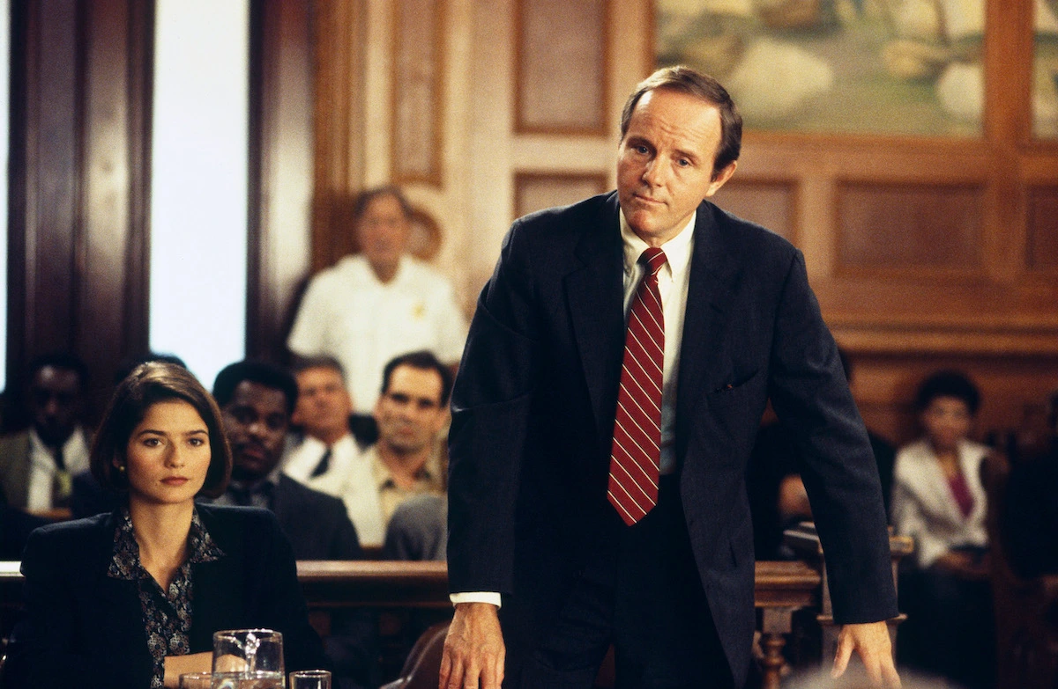
“Today, the client’s expectations of you are often shaped by the attorneys portrayed on television. Tainted by these caricatures, the client feels you have not earned your fee unless you represent him zealously, and with malice aforethought. We must not permit our standards of behavior as a profession to be shaped by cultural expectations which increasingly gravitate toward hostility.”
Judge Derek P. Pullan, Learning Professionalism and Civility – Thoughts for New Members of the Bar

Slide 11
Standard #3
Lawyers shall not, without an adequate factual basis, attribute to other counsel or the court improper motives, purpose, or conduct. Lawyers should avoid hostile, demeaning, or humiliating words in written and oral communications with adversaries. Neither written submissions nor oral presentations should disparage the integrity, intelligence, morals, ethics, or personal behavior of an adversary unless such matters are directly relevant under controlling substantive law.

Slide 12
Standard #5
Lawyers shall adhere to their express promises and agreements, oral or written, and to all commitments reasonably implied by the circumstances or by local custom

Slide 13
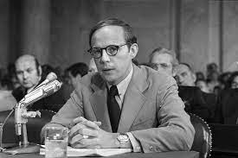
Attorney John Dean testifying before Congress during Watergate hearings

Slide 14
“How in God's name could so many lawyers get involved in something like this ...”
John Dean, White House Council to former
President Richard M. Nixon

Slide 15
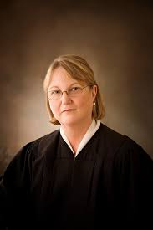
“Public trust and confidence in the American system of justice depend in significant part on the integrity and high standards of professional behavior to which every lawyer (and judge) should aspire.”
Christine M. Durham, Former Chief Justice

Slide 16
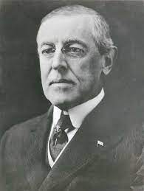
“You are not here merely to make a living. You are here in order to enable the world to live more amply, with greater vision, with a finer spirit of hope and achievement. You are here to enrich the world, and you impoverish yourself if you forget the errand.”
― Woodrow Wilson

Slide 17
Conclusion

