Slide 1
Cunningham v. Weber County – Now What?
(Drafting Enforceable Provisions to Shift Liability, and Other Effective Alternatives)

Slide 2
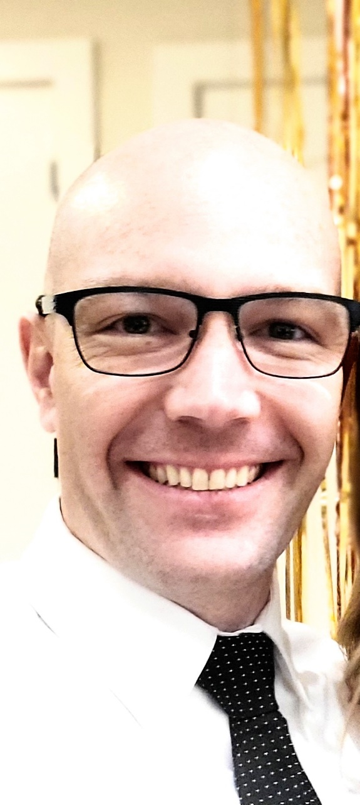
WARNING!
1. By watching my presentation, you release me from eye injuries caused by the light gleaning off my bald head. Wear Sunglasses!
2. I don’t represent you and these are my own opinions and not West Jordan’s
Notes:
1. This isn’t legal advice. 2. I don’t represent West Jordan. 3. Don’t judge me because I’m bald.

Slide 3
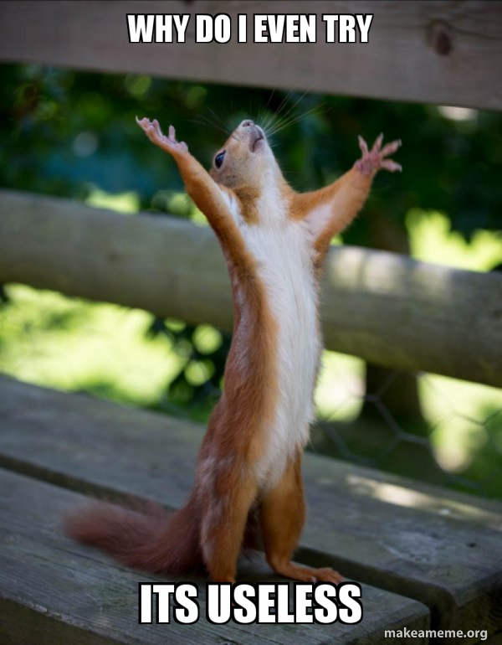
Pre-Injury Releases, Indemnification, and Limitation of Liability

Slide 4
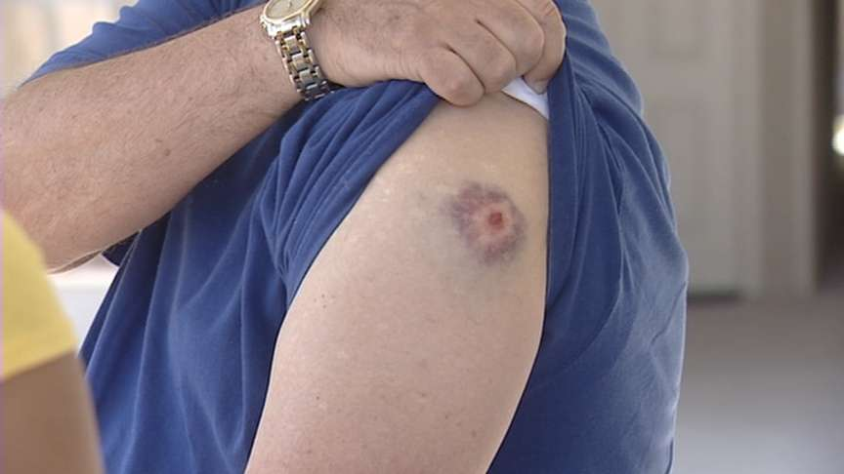
2014 Cottonwood Heights Recreation Center
2010 Liberty Park Fireworks (Salt Lake City)
Notes:
Broke 9 ribs, sternum, clavicle. Bruised lungs and heart. Suffered serious concussion and internal bleeding.

Slide 5
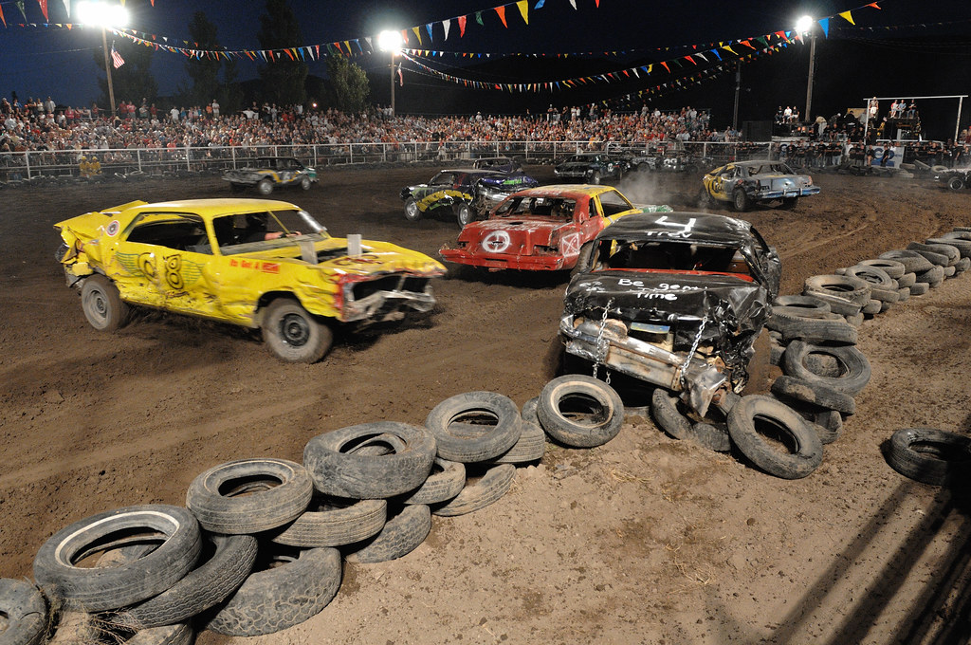
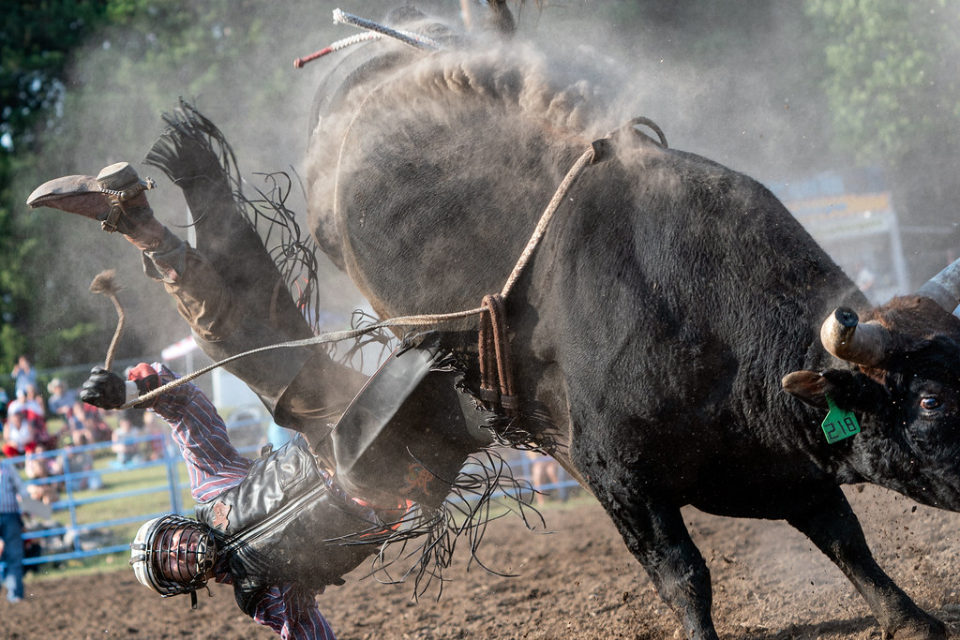
2018 Fair Days
(Wasatch County)
2020 Wrangler National Finals Rodeo (Box Elder County)
Notes:
Broke 9 ribs, sternum, clavicle. Bruised lungs and heart. Suffered serious concussion and internal bleeding.

Slide 6
Cunningham v. Weber County
Layton City firefighter paid by Layton City to attend SWAT training conducted by Weber County.
Cunningham signs release
WC trainer told Cunningham to stand too close to an explosive; Cunningham injured
Cunningham sues for negligence, gross negligence, and loss of consortium.
County moves for summary judgment

Slide 7
Cunningham v. Weber County
“Release and Waiver. I hereby unconditionally and irrevocably release and discharge the Ogden Metro SWAT Team and all related organizations and entities from any and all claims, demands, damages actions and causes of action arising, whether directly or indirectly, from or in connection with [his] attending or partipating in the described SWAT training.”

Slide 8
Cunningham v. Weber County
District Court: Grants summary judgment finding for County on all three claims.
Cunninghams appealed directly to the Supreme Court
UT Supreme Court: Overturned district court finding that the release was NOT “Clear and Unmistakable”

Slide 9
What is “Clear and Unmistakable”

Slide 10
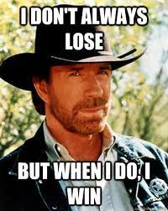
THIS IS A TEST

Slide 11
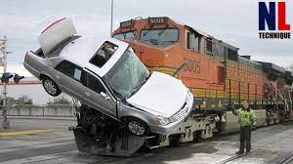
Union Pacific v. El Paso Gas
Notes:
El Paso wants to build pipeline parallel to RR. Needed an easement 50 ft. by 2 miles.
As condition of easement, required EP to sign indemnification agreement.
7 years later, El Paso employee is hit by a train, quadripalegic
Employee sues UPRR
UPRR seeks indemnification from El Paso for negligence.
“If they wanted to indemnify, then they would have used that language.”

Slide 12
Union Pacific v. El Paso Gas
“* * * from and against any and all liability, loss, damage, claims, * * * of whatsoever nature, * * *
growing out of injury or harm to or death of persons whomsoever, or loss or destruction of or damage to property whatsoever, including the pipeline, when such injury, harm, death, loss, destruction or damage, howsoever caused, grows out of or arises from the bursting of or leaks in the pipeline, or in any other way whatsoever is due to or arises because of the existence of the pipeline or the construction, operation, maintenance, repair, renewal, reconstruction or use of the pipeline or any part thereof, or to the contents therein or therefrom.”
NOT CLEAR AND UNMISTAKABLE
Notes:
El Paso wants to build pipeline parallel to RR. Needed an easement 50 ft. by 2 miles.
As condition of easement, required EP to sign indemnification agreement.
7 years later, El Paso employee is hit by a train, quadripalegic
Employee sues UPRR
UPRR seeks indemnification from El Paso for negligence.
“If they wanted to indemnify, then they would have used that language.”

Slide 13
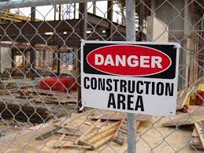
Russ v. Woodside Homes
Notes:
Russes entered into contract with Woodside to build a house.
1 month later, Russes visited site, Ms. Russ slipped and fell and died 1 month later.
Russes sued Woodside and Woodside pointed to a Release/Hold Harmless provision.

Slide 14
Russ v. Woodside Homes
“Buyer, to the fullest extent permitted by law, agrees to hold harmless Woodside (including its affiliates and subsidiaries and other contractors and subcontractors and their agents and employees) from any and all claims, damages, loss and expenses, including but not limited to attorney's fees, arising out of any death, accident, injury, or other occurrence resulting from visits to the job site by Buyer or Buyer's family or other guests.”
CLEAR AND UNMISTAKABLE
Notes:
Russes entered into contract with Woodside to build a house.
1 month later, Russes visited site, Ms. Russ slipped and fell and died 1 month later.
Russes sued Woodside and Woodside pointed to a Release/Hold Harmless provision.
Court said it is clear and unmistakeable.

Slide 15
Healey v. J.B. Sheet Metal
Notes:
Richard Healey and coworker go to pour concrete on a second level floor.
They try to move heating duct that was covering an opening in the floor. Healey fell through.
Healey sued GC, Mechanical Subcontract, Sheet Metal Contractor.
Many cross-claims for indemnification, including the GC against his subcontractor based on an indemnification provision he had with his sub.

Slide 16
Healey v. J.B. Sheet Metal
“Sub-Contractor shall indemnify and save General Contractor, its officers or agents harmless from and against any and all loss, damage, injury, liability, and claims thereof for injuries to or death of persons, and all loss of or damage to property of others, resulting directly or indirectly from Sub-Contractor's performance of this contract.”
NOT CLEAR AND UNMISTAKABLE
Notes:
Richard Healey and coworker go to pour concrete on a second level floor.
They try to move heating duct that was covering an opening in the floor. Healey fell through.
Healey sued GC, Mechanical Subcontract, Sheet Metal Contractor.
Many cross-claims for indemnification, including the GC against his subcontractor based on an indemnification provision he had with his sub.

Slide 17
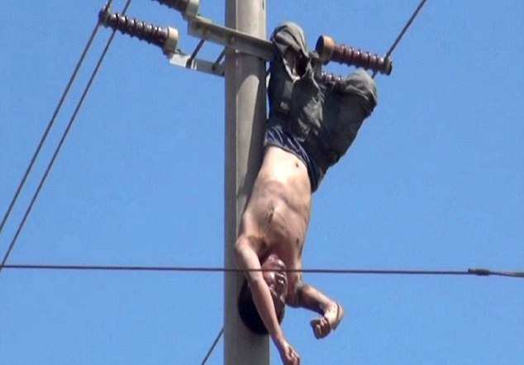
Freund v. Utah Power & Light
Notes:
Anybody from Washington City, Utah?
Freund is injured when he is working for a cable TV company attaching line to UP and L’s line under an Attachment Agreement.
Agreement states that UPL is indemnified against anything resulting from their activities.

Slide 18
Freund v. Utah Power & Light
“Licensee shall indemnify, protect, and save harmless Licensor from and against any and all claims, demands, causes of action, costs or other liabilities for damages to property and injury or death to persons which may arise out of or be connected with the erection, maintenance, presence, use or removal of Licensee’s equipment . . . .”
“Except for intentional wrongdoing or willful negligence on the part of Licensor, or any of its agents or employees, Licensee shall also indemnify, protect, and save harmless Licensor from and against any and all claims, demands, causes of action, costs, or other liabilities arising from any interruption, discontinuance, or interference with Licensee’s service . . . .”
CLEAR AND UNMISTAKABLE
Notes:
Anybody from Washington City, Utah?
Freund is injured when he is working for a cable TV company attaching line to UP and L’s line under an Attachment Agreement.
Agreement states that UPL is indemnified against anything resulting from their activities.

Slide 19
doTERRA v. Kruger
Rob
Notes:
Rob Wall has taken up in his retirement of a Doterra Salesperson. This one is for him.
Kruger is like Rob, a distributor – a “Wellness Advocate” purchased product to sell.
Kruger applied product called “ClaryCalm” to her skin before visiting a tanning salon and ended up with second and third degree burns.
Kruger sued Doterra seeking among other things punitive damages.
Against public policy, but is it clear and unmistakable?

Slide 20
doTERRA v. Kruger
“I release and agree to indemnify doTERRA and its affiliates from any and all liability, damages, fines, penalties, or other awards or settlements arising from, or relating to my actions in the promotion of my doTERRA independent business and any activities related to it . . . . doTERRA shall not be liable for any: . . . Special, indirect, incidental, punitive, or consequential damages, including loss of profits, arising from or related to the operation of use of the products . . . .”
NOT CLEAR AND UNMISTAKABLE
Notes:
Rob Wall has taken up in his retirement of a Doterra Salesperson. This one is for him.
Kruger is like Rob, a distributor – a “Wellness Advocate” purchased product to sell.
Kruger applied product called “ClaryCalm” to her skin before visiting a tanning salon and ended up with second and third degree burns.
Kruger sued Doterra seeking among other things punitive damages.
Against public policy, but is it clear and unmistakable?

Slide 21
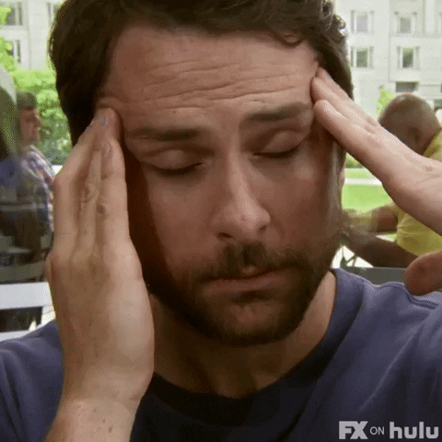
What Now?

Slide 22
Is YOUR Language “Clear and Unequivocal”?
City Recreation Release
“I, the undersigned . . . In consideration of the permission granted to me by the City . . . and City Recreation to participate in this recreation program, do hereby release, forever discharge and agree to Hold Harmless City, City Recreation, and its elected officials, officers, its authorized agents, employees and volunteers, for all claims, damages, demands, actions and causes of the action at law or in equity, arising by reason or in manner growing out of participation in City Recreation Programs.”
City Volunteer Waiver
“I hereby waive and release any and all claims I have or may have in the future against the City, its officers, agents, employees, assigns, and sureties, for any liability, damage, claim, injury, loss, expense, attorney fees, or harm of any kind whatsoever arising out of my participation in the Project.

Slide 23
No Need for Specific Words . . . BUT
“Enforceable when the broad sweep of the language . . . clearly covers those instances in which a party may be negligent.”
“That is not to say that a release must use specific words to make its intent clear and unmistakable.”
Notes:
Freund v. UP&L

Slide 24
No Need for Specific Words . . . BUT
“Enforceable when the broad sweep of the language . . . clearly covers those instances in which a party may be negligent.”
“That is not to say that a release must use specific words to make its intent clear and unmistakable.”
NOT REALLY TRUE!
Notes:
Freund v. UP&L

Slide 25
So…Words Really Do Matter

Slide 26
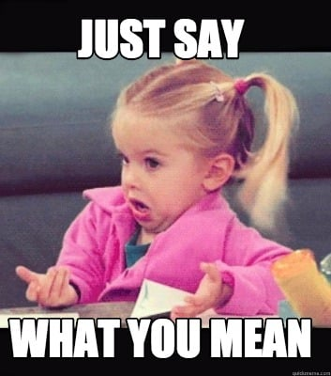
Tips to Make “Clear and Unmistakable”
Only ONE interpretation

Slide 27
Tips to Make “Clear and Unmistakable”
Use the terms “any and all,” “liability,” and “negligence” - Healey v. J.B. Sheet Metal
Exclude certain types or use conditional language – “Except for intentional wrongdoing and gross negligence” – Freund v. UP&L
Be specific about the type of release or indemnification you are asking for. – “Arising out of injuries or Arising out of this Agreement.” - El Paso v. Union Pacific

Slide 28
Tips to Make “Clear and Unmistakable”
And, indeed, doTERRA’s waiver does not resemble those we have found to be clear and unmistakable. For example, in Pearce the waiver shouted that it applied to “ANY AND ALL LIABILITY, CLAIMS, DEMANDS, AND CAUSES OF ACTION WHATSOEVER ARISING OUT OF OR RELATED TO ANY LOSS, DAMAGE, OR INJURY, INCLUDING DEATH.”ty

Slide 29
Tips to Make “Clear and Unmistakable”
Bold
Italicized
Underlined
ALL CAPS
Colored
Font:Indemnity…Indemnity…Indemnity
Spacing
Spacing
Spacing
HEADINGS
Indenting
Size: Indemnity…Indemnity…Indemnity…Indemnity…Indemnity

Slide 30
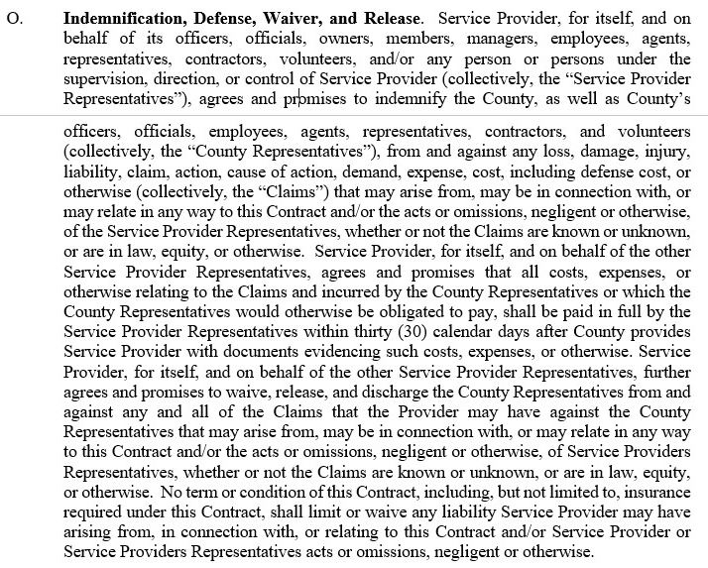
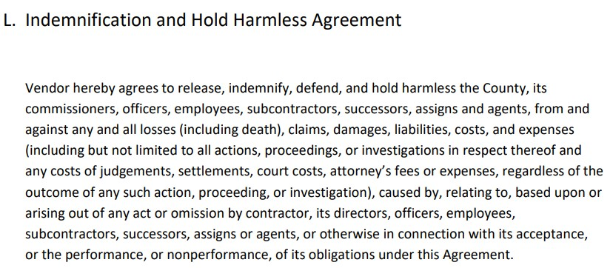
Examples

Slide 31
Indemnification for Negligence Must Not Violate Public Policy or Prohibited
Architect, Engineer, or Surveyor Services (UCA 13-8-7)
Construction Contracts (UCA 13-8-1) (Thoroughly analyze!!)
Indemnification by Parents of Minors
Others – See UCA Title 78B, Chapter 4
Notes:
Architect:
a) No indemnification or responsibility unless liability is caused by the design professional’s breach of contract, negligence, recklessness, or intentional misconduct or the design professional’s subconsultant’s negligence.
b) No defending – no exclusions
Construction Contracts:
Courts interpret this to mean all contracts related to construction whether owner or not.
-Legislative history
-Insurance certificate and additional insured (Arising Out of)
Minors:
Indemnification by Parents of Minors (case law)
No indemnification by parents if minor is injured because of the negligence of the indemnitee.
Exception: Livestock Sponsors (AKA County Fair)

Slide 32
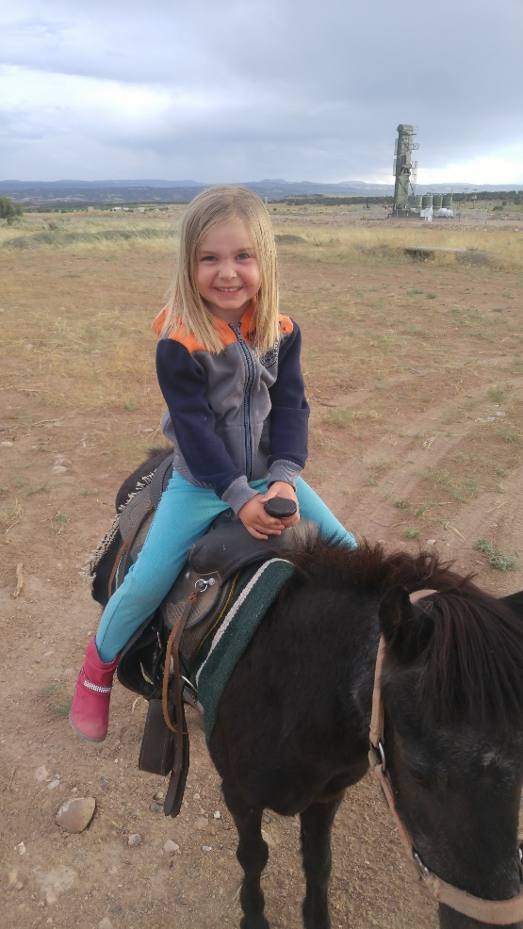
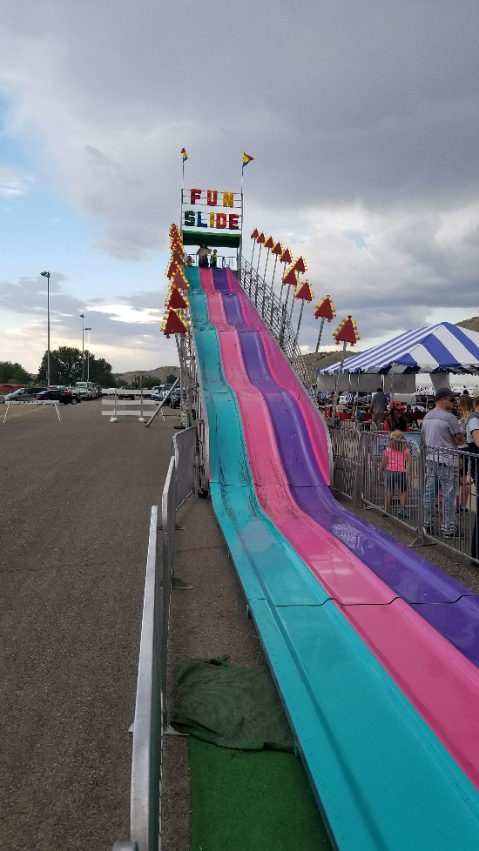
Indemnification/Pre-Injury Release
Signed by Parent for Minor
A
B
C
Notes:
How many of you have signed a waiver to allow your minor children to participate in an activity and then start laughing because you know they are not enforceable? I have. CLICK TO POPULATE. I want to ask the question though, if I were to sign a waiver with each of these activities for my kids to participate and they released the entity of their own negligence and say my kid was hurt, which one, if any, would I be able to be stopped from collecting on?

Slide 33
Indemnification/Pre-Injury Release
Signed by Parent for Minor
A
B
C
Notes:
How many of you have signed a waiver to allow your minor children to participate in an activity and then start laughing because you know they are not enforceable? I have. CLICK TO POPULATE. I want to ask the question though, if I were to sign a waiver with each of these activities for my kids to participate and they released the entity of their own negligence and say my kid was hurt, which one, if any, would I be able to be stopped from collecting on?

Slide 34
Fairs, Rodeos, 4-H, Etc.
Notes:
Architect:
a) No indemnification or responsibility unless liability is caused by the design professional’s breach of contract, negligence, recklessness, or intentional misconduct or the design professional’s subconsultant’s negligence.
b) No defending – no exclusions
Construction Contracts:
Courts interpret this to mean all contracts related to construction whether owner or not.
-Legislative history
-Insurance certificate and additional insured (Arising Out of)
Minors:
Indemnification by Parents of Minors (case law)
No indemnification by parents if minor is injured because of the negligence of the indemnitee.
Exception: Livestock Sponsors (AKA County Fair)

Slide 35
Fairs, Rodeos, 4-H, Etc.
Notes:
Architect:
a) No indemnification or responsibility unless liability is caused by the design professional’s breach of contract, negligence, recklessness, or intentional misconduct or the design professional’s subconsultant’s negligence.
b) No defending – no exclusions
Construction Contracts:
Courts interpret this to mean all contracts related to construction whether owner or not.
-Legislative history
-Insurance certificate and additional insured (Arising Out of)
Minors:
Indemnification by Parents of Minors (case law)
No indemnification by parents if minor is injured because of the negligence of the indemnitee.
Exception: Livestock Sponsors (AKA County Fair)

Slide 36
Equine and Livestock Act
(UCA 78B-4-201 to 203)
Exempts for inherent risks of equine and livestock activities IF you give notice by signs OR release to participant (definitions are important).
Everything else, the sponsor is liable for own negligence.
EXCEPT, Releases are enforceable for own negligence, (EVEN FOR MINORS!!!) – Penunuri v. Sundance Partners, 2013 UT 22

Slide 37
Equine and Livestock Act
(UCA 78B-4-201 to 203)
Equine and Livestock Activity Definition – Look It Up
Inherent Risks Definition:
“dangers or conditions which are an integral part of equine or livestock activities, which may include:
(a) the propensity of the animal to behave in ways that may result in injury, harm, or death to persons on or around them;
(b) the unpredictability of the animal’s reaction to outside stimulation such as sounds, sudden movement, and unfamiliar objects, persons, or other animals;
(c) collisions with other animals or objects; or
(d) the potential of a participant to act in a negligent manner that may contribute to injury to the participant or others, such as failing to maintain control over the animal or not acting within his or her ability.”

Slide 38
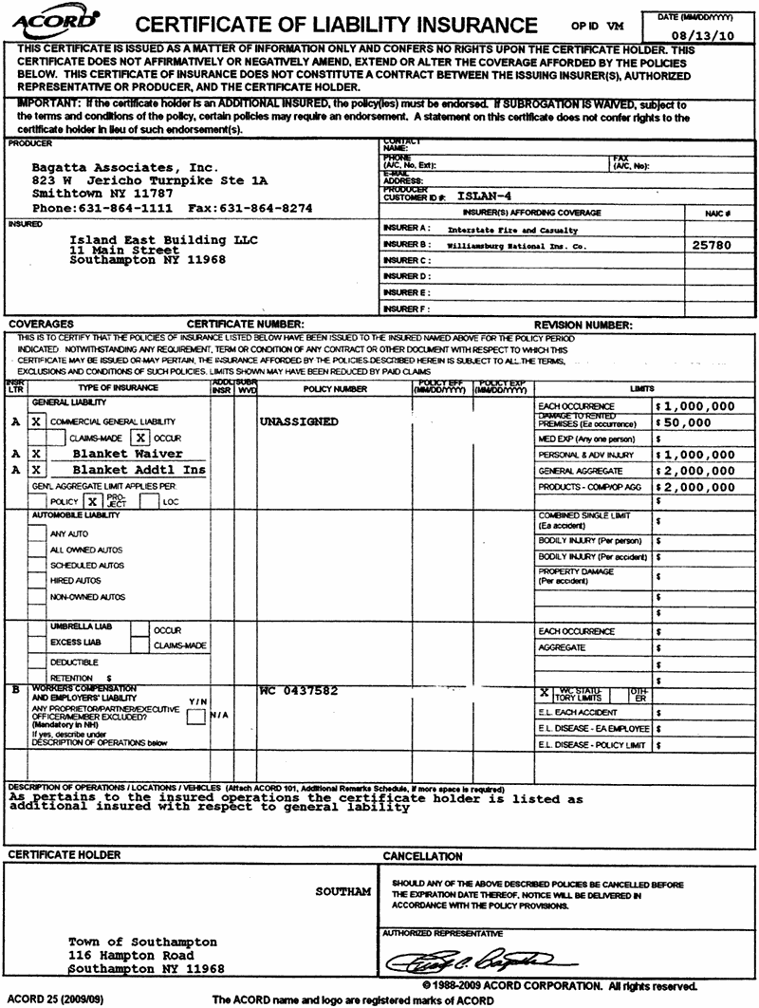
Insurance Certificates
Who requests these in bid documents?
Who requests the insurance policy?
Who requests endorsements and limitations?
Who has no idea?
Who knows, but just doesn’t want to raise their hand?

Slide 39
Alternatives to COI’s
Request all endorsements
Request exclusion list
Request the entire policy if high risk activity (possible threshold)
Additional insured language (ensure contract language matches up)

Slide 40
Negotiations with Other Parties Requiring City to Indemnify
Use Unclear Language to Your Advantage
Reduce statute of limitations
Cap (or no cap) on damages
Notes:
Switching Gears

Slide 41
Party Indemnifies You:
Use “Arising Out of” or “Related to”
You Indemnify Other Party:
Use “Caused by”
“Ordinarily understood to mean originating from, incident to, or in connection with the item in question.”
Some nexus must exist, but do not have to prove the damage was “caused by”
Notes:
Meadow Valley Contractors v. Transcon – 2001 UT App 190

Slide 42
Parties Requiring City to Indemnify
Reduction of Statute of Limitations
Utah Statute of Limitations:
Written contract – 6 years
Oral contract – 4 years
Wrongful death – 2 years
Personal property damages – 3 years
If another party is indemnifying you, always extend the contract beyond the termination date of the contract or performance (survivability) to last until all SOL’s have expired.

Slide 43
Parties Requiring City to Indemnify
Reduction of Statute of Limitations (in cases where you must indemnify someone else)
“Parties may contractually limit the time in which to bring an action in contract to a period shorter than that of the applicable statute of limitations, so long as the limitation is reasonable.” – Wallace v. C.R. Eng., Inc., 2018 U.S. Dist. LEXIS 60813
Reasonable: “period of thirty days was not unreasonable”; “six-month limitations period was not unreasonable and was enforceable.”

Slide 44
Parties Requiring City to Indemnify
Limitation of Liability (Caps) ≠ Indemnification
Governmental Immunity Act Caps:
Personal Injury:
$827,000 per person per occurrence
$3,329,100 aggregate per occurrence
Property Damage:
$326,200 per occurrence
Example: “In no event shall the City be responsible to indemnify contractor for any liability or loss in an amount greater than $250,000 or the cost of goods or services provided, whichever is less.”
Notes:
Limitation of Liability Clauses are not Indemnification Clauses and are valid – Blaisdell v. Dentrix

Slide 45
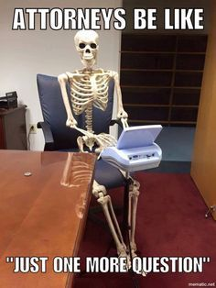
Questions?
Jared Tingey
Work: 801-569-5161
Personal Cell: 801-540-9869
jaredtingey@gmail.com

